Slide 1


Introduction to Bash Scripting and Automation in the Cloud
| DevOps and Cloud Computing

Slide 2

Objective
Understand the basics of Bash scripting and its importance in automation.
Learn to launch and connect to an EC2 instance using VSCode.
Explore shell scripting fundamentals, including syntax and common commands.
Identify tasks suitable for automation in cloud and development workflows.

Slide 3
Explaining what Bash scripting is and why it’s widely used

Slide 4
Bash scripting
Bash scripting is a scripting language used to automate tasks in UNIX/Linux environments by writing sequences of commands in a text file (.sh extension) that the Bash shell executes.
It starts with a shebang line (#!/bin/bash) to specify the interpreter and allows variables, loops, conditionals, and direct system command integration.
Key reasons for its widespread use:
Task automation
Deep OS integration
Portability
Efficiency
Ease of learning

Slide 5
Pop Quiz
Q. What does the shebang line (#!) in a Bash script specify?
A
The interpreter to be used for executing the script
B
The version of Bash being used

Slide 6
Pop Quiz
Q. What does the shebang line (#!) in a Bash script specify?
A
The interpreter to be used for executing the script
B
The version of Bash being used

Slide 7
Common use cases: task automation, system management, and deployment scripts.

Slide 8
Common Use Cases of Automation
Automation has become an essential tool across various domains, enhancing efficiency and accuracy in numerous processes. The three primary use cases of automation include task automation, system management, and deployment scripts.
Task Automation
Task automation involves using software to perform repetitive tasks without human intervention. Common use cases include:
Data Entry
Email Notifications
Report Generation Appointment Scheduling

Slide 9
Common Use Cases of Automation
System Management
System management automation focuses on maintaining and overseeing IT systems with minimal manual effort. Key use cases include:
Configuration Management
Monitoring and Alerts
Resource Allocation
Deployment Scripts
Deployment automation involves using scripts to manage the release of software updates seamlessly. This includes:
Continuous Integration/Continuous Deployment (CI/CD)
Automated Testing
Version Control Integration

Slide 10
Demonstrating writing a simple Bashscript to automate repetitive tasks (e.g., file creation).

Slide 11
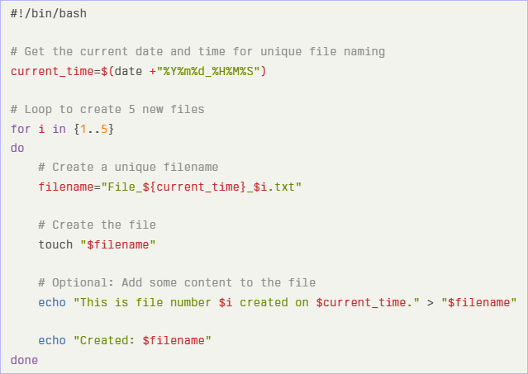
Let’s do it
Simple Bash Script to Automate File Creation
Below is a simple Bash script that automates the creation of multiple text files. Each time you run the script, it will create five new files with unique names based on the current date and time.

Slide 12
Introducing AWS EC2 and its relevance for cloud computing.

Slide 13
Introducing AWS EC2
Amazon Elastic Compute Cloud (EC2) is a core component of Amazon Web Services (AWS) that provides scalable computing capacity in the cloud. It enables users to launch and manage virtual servers, known as instances, on-demand, allowing for significant flexibility and cost savings in computing resources.
Relevance in Cloud Computing
AWS EC2 plays a pivotal role in cloud computing by:
Reducing Costs
Enabling Rapid Deployment
Supporting Diverse Workloads

Slide 14
Demonstrating the steps to launch an EC2 instance

Slide 15
Let’s do it
To launch an EC2 instance on AWS, follow these steps:
Step 1: Choose an Amazon Machine Image (AMI)
Log in to the AWS Management Console and navigate to the EC2 Dashboard.
Click on the Launch Instance button.
Under Application and OS Images (Amazon Machine Image), select the Quick Start tab.
Choose an AMI that suits your needs. For beginners, selecting Amazon Linux or any Free Tier eligible AMI is recommended.

Slide 16
Let’s do it
Step 2: Configure Instance Details
Instance Type
Configure Instance Details
Step 3: Configure Security Groups
In the Configure Security Group section, create a new security group or select an existing one.
Define inbound rules to control traffic (e.g., allow SSH access on port 22).
Ensure that you set appropriate rules for your use case.

Slide 17
Let’s do it
Step 4: Key Pairs
Under Key pair (login), choose an existing key pair or create a new one.
If creating a new key pair, download the private key file (.pem) and store it securely, as it will be needed to access your instance.
Final Steps
Review all settings to ensure everything is configured correctly.Click on the Launch button to start your EC2 instance.

Slide 18
How to connect to the EC2 instance using VSCode and the Remote - SSH extension.

Slide 19
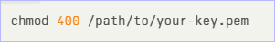
Let’s do it
Step 1: Install the Remote - SSH Extension
Open VSCode.
Click on the Extensions icon in the sidebar or press Ctrl + Shift + X.
Search for Remote - SSH by Microsoft and click Install.
Step 2: Configure SSH Access
Open your terminal and set permissions for your SSH key:
Test your SSH connection to ensure it works:

Slide 20
Let’s do it
Step 3: Add the EC2 Instance to SSH Configuration
In VSCode, open the Command Palette by pressing Ctrl + Shift + P.
Type and select Remote-SSH: Add New SSH Host....
Enter the SSH connection string:
Choose to save this configuration in the default SSH config file (usually located at ~/.ssh/config).
Step 4: Connect to Your EC2 Instance
Again, open the Command Palette and select Remote-SSH: Connect to Host....
Choose your EC2 instance from the list of configured hosts.
If prompted, enter your SSH key passphrase.

Slide 21


Take A 5-Minute Break!
Stretch and relax
Hydrate
Clear your mind
Be back in 5 minutes

Slide 22
The structure of a shell script (shebang line, commands, and comments).

Slide 23
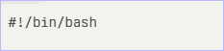
The structure of a shell script
A shell script is a text file containing a series of commands that the shell interprets and executes. The structure of a shell script typically includes the following components:
Shebang Line
The shebang line is the first line of a shell script and begins with #!. It specifies the interpreter that should be used to execute the script. For example, a common shebang for Bash scripts is:

Slide 24
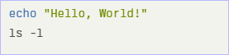
The structure of a shell script
Commands
The main body of the script consists of a series of commands that are executed sequentially. These can be built-in shell commands, external programs, or custom functions. For example:

Slide 25
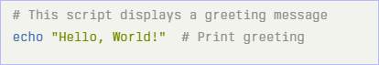
The structure of a shell script
Comments
Comments are used to provide explanations or documentation within the script. They are ignored by the interpreter and are denoted by the # symbol. For example:
Comments help make scripts more understandable for others (or for yourself when revisiting your code later).

Slide 26
Pop Quiz
Q. Which symbol is used to denote a comment in a shell script?
A
//
B
#

Slide 27
Pop Quiz
Q. Which symbol is used to denote a comment in a shell script?
A
//
B
#

Slide 28
Basic syntax: variables, loops (for, while), and conditionals (if, else).

Slide 29
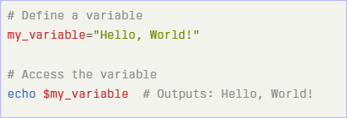
Basic syntax
1. Variables
In Bash, you can define variables without specifying a type. The syntax is straightforward:
Note: There should be no spaces around the ‘=‘ sign when assigning a value to a variable.

Slide 30
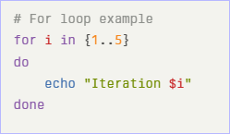
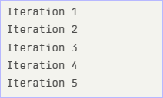
Basic syntax
2. Loops
For Loop
A ‘for’ loop is used to iterate over a list of items or a range of numbers.
This will output:

Slide 31
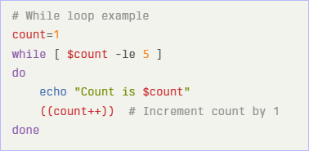
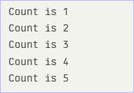
Basic syntax
While Loop
A ‘while’ loop continues executing as long as a specified condition is true.
This will output

Slide 32
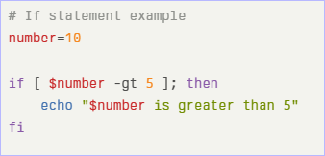
Basic syntax
3. Conditionals
If Statement
An ‘if’ statement allows you to execute commands based on whether a condition is true.

Slide 33
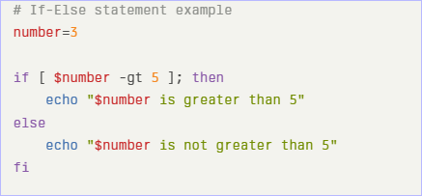
Basic syntax
If-Else Statement
You can extend the ‘if’ statement with an ‘else’ clause to handle alternative conditions.

Slide 34
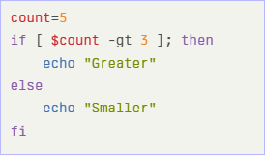
Pop Quiz
Q. What will be the output of this code snippet?
A
Greater
B
Smaller

Slide 35
Pop Quiz
Q. What will be the output of this code snippet?
A
Greater
B
Smaller

Slide 36
Demonstrating common commands

Slide 37
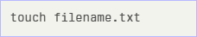
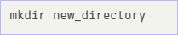
Lets do it
File Operations
Creating Files: ‘touch’
The touch command is used to create an empty file or update the timestamp of an existing file.
Creating Directories: ‘mkdir’
To create a parent directory along with a child directory, use:

Slide 38
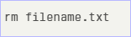
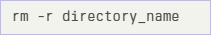
Lets do it
Removing Files: ‘rm’
To remove a directory and its contents recursively, use:
Process Management
Viewing Processes: ‘ps’

Slide 39
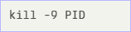
Lets do it
Killing Processes: ‘kill’
To forcefully kill a process, you can use:
Networking Commands
Checking Connectivity: ‘ping’
Fetching Data: ‘curl’

Slide 40
Pop Quiz
Q. How do you remove a file named example.txt?
A
rm example.txt
B
rmdir example.txt

Slide 41
Pop Quiz
Q. How do you remove a file named example.txt?
A
rm example.txt
B
rmdir example.txt

Slide 42
Pop Quiz
Q. Which command is used to check network connectivity to a host?
A
curl
B
ping

Slide 43
Pop Quiz
Q. Which command is used to check network connectivity to a host?
A
curl
B
ping

Slide 44
Discussing automation scenarios

Slide 45
Automation Scenarios
System Maintenance Tasks (Backups, Log Rotation):
Automation Tools: Use cron or anacron to schedule regular backups and log rotations.
For example, a shell script can be set to run daily at midnight to back up important directories and rotate logs, ensuring system performance and data integrity without manual intervention. This enhances reliability and reduces the risk of human error.

Slide 46
Automation Scenarios
Cloud Resource Management (Starting/Stopping EC2 Instances):
Automation Tools: Utilize AWS CLI or SDKs to automate the management of EC2 instances. Scripts can be scheduled to start or stop instances based on usage patterns or specific times, optimizing costs and resource allocation.
For instance, instances can be automatically stopped during off-peak hours and started again during business hours.

Slide 47
Automation Scenarios
DevOps Workflows (CI/CD Pipelines):
Automation Tools: Implement CI/CD tools like Jenkins, GitLab CI, or CircleCI to automate the software development lifecycle. These tools can trigger builds, run tests, and deploy applications automatically upon code changes in the repository.
This streamlines the development process, reduces time-to-market, and ensures consistent deployment practices.

Slide 48
Time for case study!

Slide 49
Important
Complete the post-class assessment
Complete assignments (if any)
Practice the concepts and techniques taught in this session
Review your lecture notes
Note down questions and queries regarding this session and consult the teaching assistants

Slide 50
Thanks!

